Slide 1
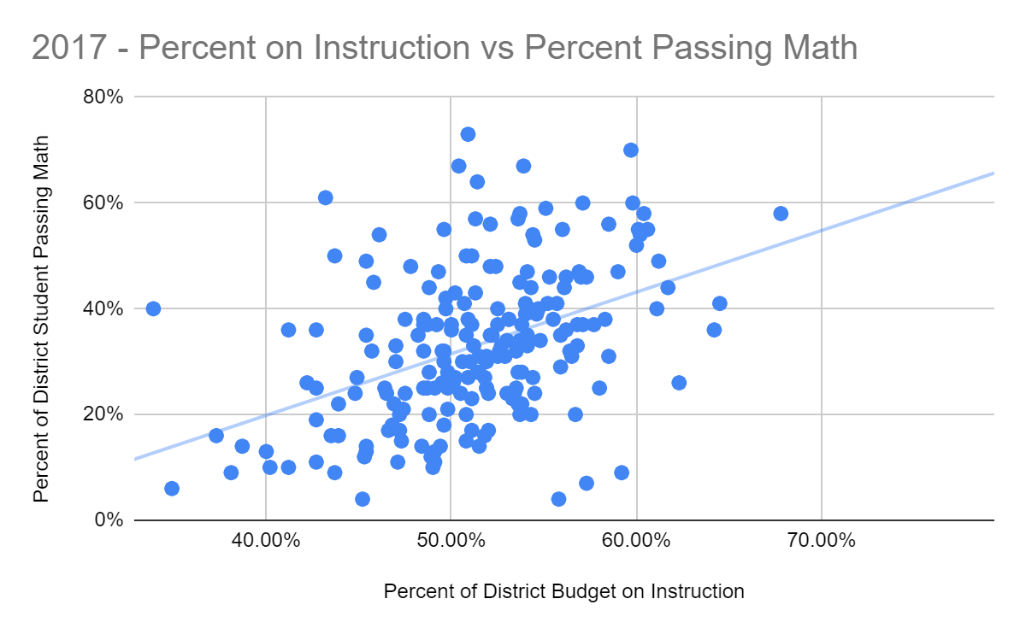
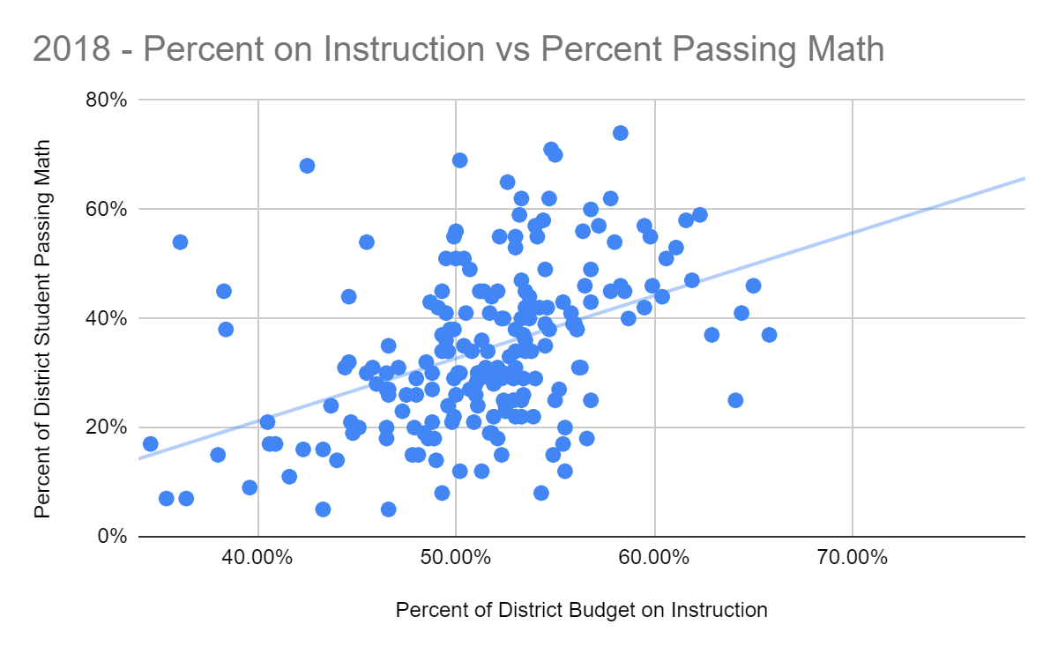
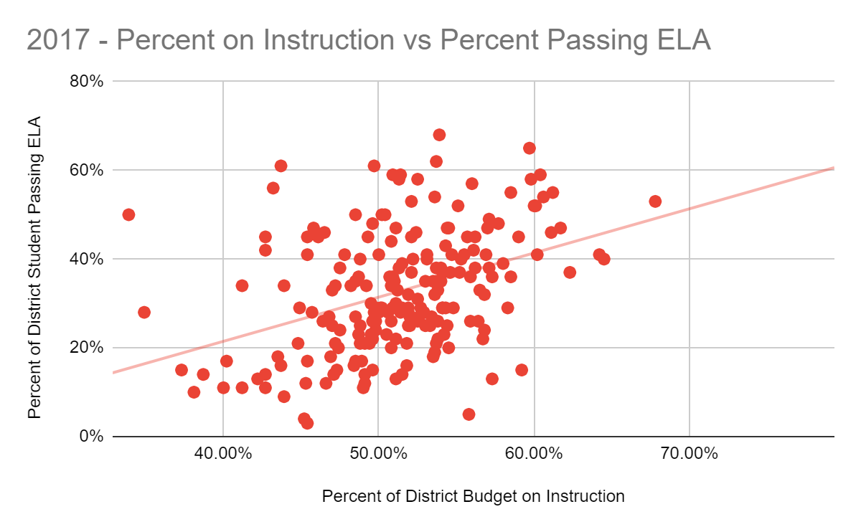
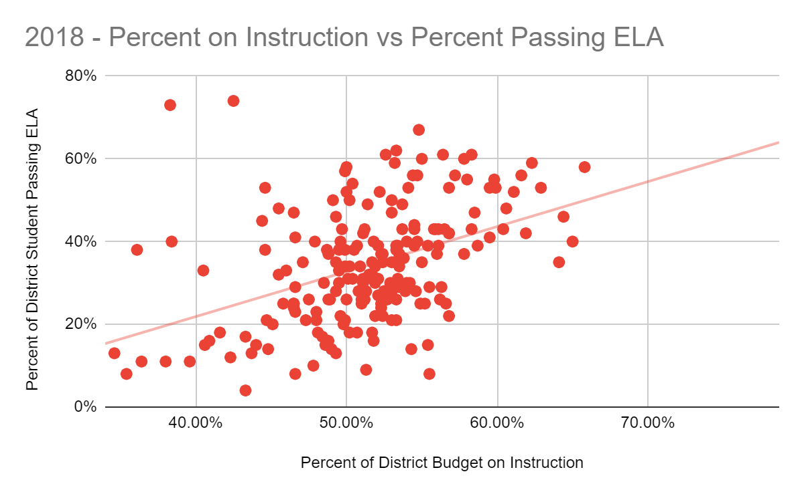
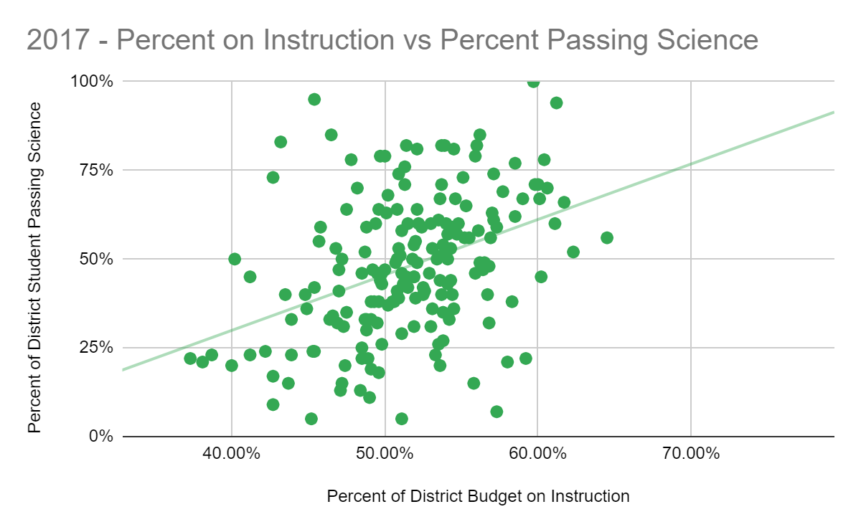
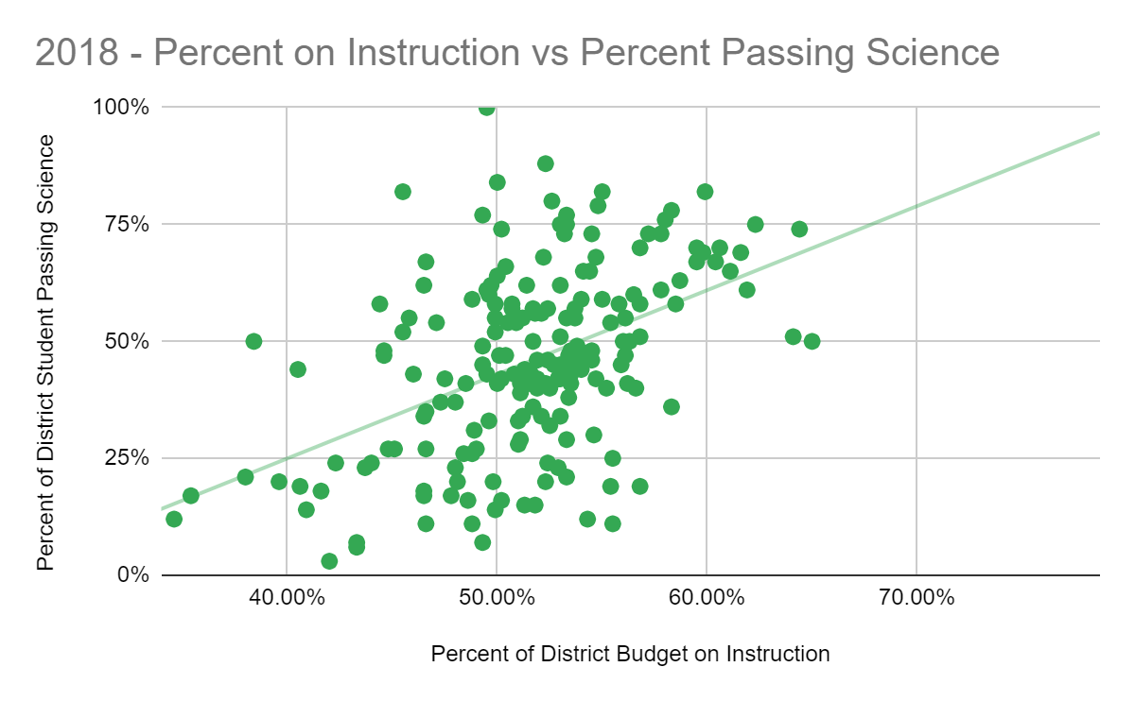
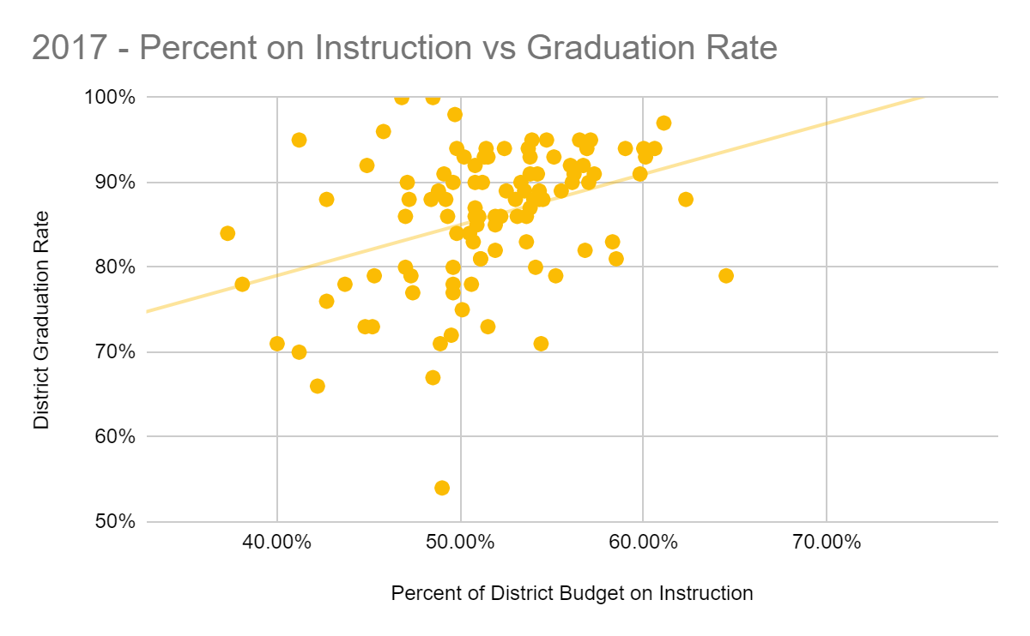
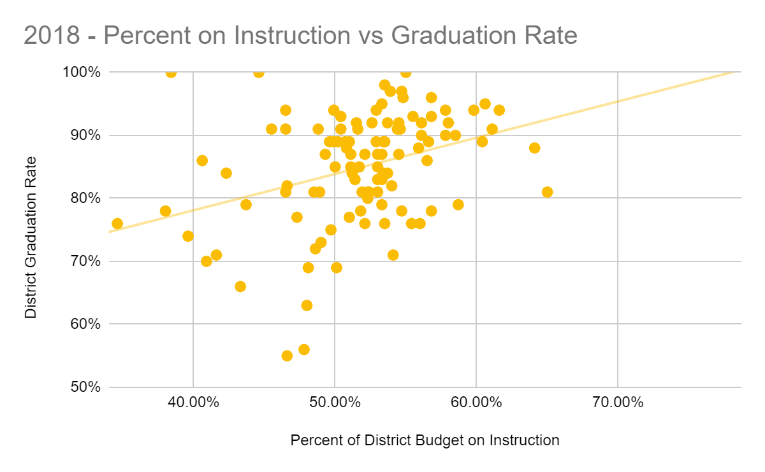
Correlation between Arizona school districts’ percentage spent on instruction and students’ performance.
By Justin Colyar
Decision Center for Educational Excellence at Arizona State University
Introduction
Results (continued)
Conclusions
Since a significant portion of a state’s budget is spent on education, school spending has often been analyzed for correlations with student outcomes. Moreover, since Janet Napolitano’s administration, the goal has been to increase spending on instruction. To further understand how school spending and ratios affect teachers and students, data from the 2017 and 2018 Arizona Auditor General’s Report on Arizona District Spending has been examined for:
AIMS Science Scores
AzMERIT Math Scores
AzMERIT ELA Scores
Graduation Rate
In addition, the average teacher salary compared with the average years of teacher experience for each district was also analyzed.
There were many factors that were not explored including per pupil spending on food, transportation, land, interest, etc.
Districts that spent a larger percentage of their budget on instruction had higher graduation rates, AzMERIT scores, and AIMS Science scores.
For Arizona school districts…
Increased instructional spending had a moderate correlation to student performance and graduation rate.
More experienced teachers have some positive correlation to both teacher salary and student testing.
Student performance had little correlation to spending on administration, student support services, or the administrator to student ratio.
It should be noted that this data is at the district level and not controlled for student characteristics or school level effects. Further research is needed at the school level for clarification.
Percent Districts Spent on Instruction
Percent Districts Spent on Administration
Percent Districts Spent on Student Support Services
District Teacher Experience
Administrator to Student Ratio
VS
Limitations
Limits
Effects on Analysis
Student populations were not controlled.
Only 2017 and 2018 data were available for use.
Analysis was conducted at the district level.
May be controlling, underlying factors in trends like income.
Higher standard deviation in results is to be expected due to small sample size of years
Trends are expected to be diminished because of averaging across multiple schools.
Data
All data used was taken for the annual public reports conduct by Arizona Auditor General on Arizona school district spending from the fiscal years 2017 and 2018.
Future Research
With the ESSA requirement that districts report school spending, it will be possible in the future to examine these relationships at the school level. Moreover, analyzing these same trends with controlled student populations would allow for a clearer understandings of these relationships.
Results
Interestingly, student support expenditures, such as on counselors, were not strongly associated with better student outcomes. There were weak correlations in the data between teachers with more experience and students with better performances on Arizona’s standard exams along with more experienced teachers and higher teacher salaries. For most other trends examined with student performance metrics, including the percentage a district spent on administration, and the students per administrator, there were no strong correlations in the data.
Acknowledgements
I would like to thank the Decision Center for Educational Excellence at Arizona State University for its continued support, work, and resources that they put forth to help improve educational outcomes in Arizona. I would also like to thank Mr. Lukas Wenrick and Dr. Joe O’Reilly for being editors and close supporters in advising the direction of this project.

